Slide 1

a presentation of
Possible Depression Factors Research
Featuring a dataset of anonymous survey responders
by Kamil Alyakaev, Stanislav Ushakov and Maxim Kolodyazhny

Slide 2
The Dataset
IQ Score
Life Satisfaction Score
Depression Score
Social Support Score
Stress Level
Attention Score
Anxiety Level
Memory Score
Self-Esteem Score
Age
1

Slide 3
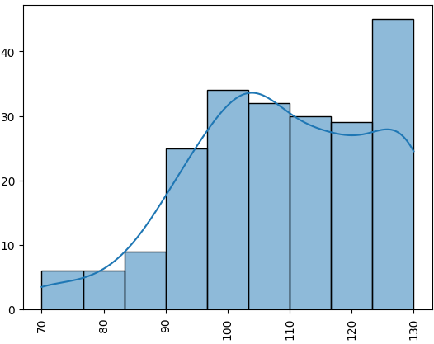
The Dataset
Life Satisfaction Score
IQ Score
Mean: 108.7
Std: 15.231 Min: 71 Max: 130
Depression Score
Social Support Score
Stress Level
Attention Score
Represents an individual's cognitive abilities in comparison to the average population. It is a measure of various cognitive abilities and is considered an indicator of intellectual potential.
Anxiety Level
Memory Score
Self-Esteem Score
Age

Slide 4
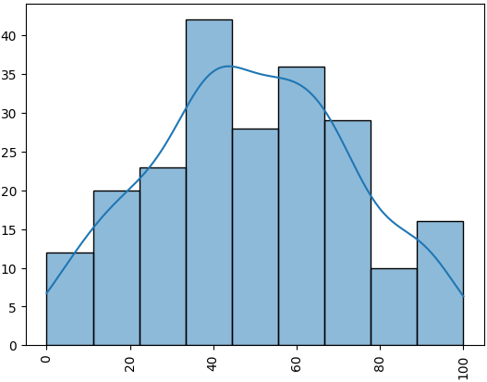
The Dataset
Depression Score
IQ Score
Life Satisfaction Score
Mean: 49.27
Std: 23.6 Min: 0 Max: 98
Social Support Score
Stress Level
Attention Score
Indicates the level of depressive symptoms an individual is experiencing. Higher scores represent more severe symptoms of depression.
Anxiety Level
Memory Score
Self-Esteem Score
Age
1.1

Slide 5
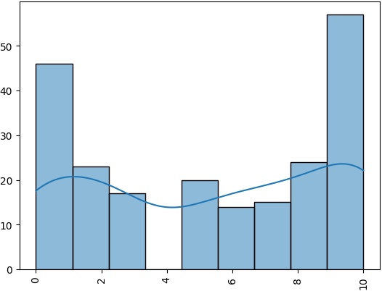
The Dataset
Stress Level
IQ Score
Life Satisfaction Score
Mean: 5.3
Std: 3.6 Min: 0 Max: 10
Depression Score
Social Support Score
Attention Score
Reflects the level of psychological stress experienced by an individual. Higher levels indicate greater stress.
Anxiety Level
Memory Score
Self-Esteem Score
Age
1.2

Slide 6
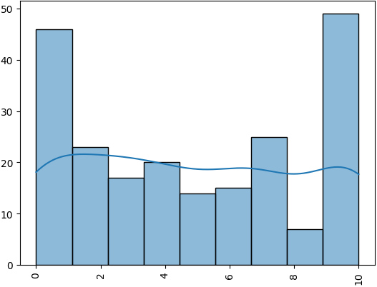
The Dataset
Anxiety Level
IQ Score
Life Satisfaction Score
Mean: 4.8
Std: 15.9 Min: 0 Max: 10
Depression Score
Social Support Score
Stress Level
Attention Score
Measures the level of anxiety symptoms. Higher values indicate more severe anxiety.
Memory Score
Self-Esteem Score
Age
1.3

Slide 7
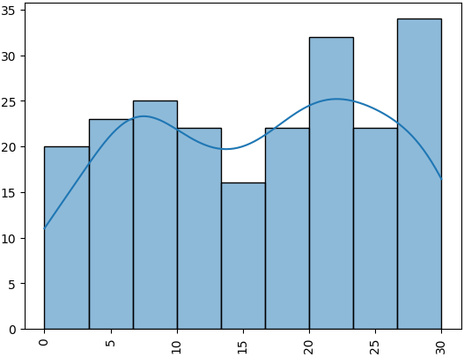
The Dataset
Self-Esteem Score
IQ Score
Life Satisfaction Score
Mean: 15.99
Std: 9.2 Min: 0 Max: 30
Depression Score
Social Support Score
Stress Level
Attention Score
Reflects an individual's overall subjective sense of personal worth or value. Higher scores indicate higher self-esteem.
Anxiety Level
Memory Score
Age
1.4

Slide 8
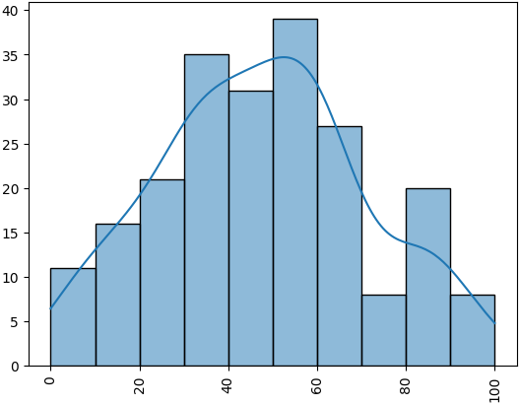
The Dataset
Life Satisfaction Score
IQ Score
Mean: 47.6
Std: 23.21 Min: 2 Max: 100
Depression Score
Social Support Score
Stress Level
Attention Score
Assesses an individual's overall satisfaction with their life, including personal achievements, relationships, and emotional well-being.
Anxiety Level
Memory Score
Self-Esteem Score
Age
1.5

Slide 9
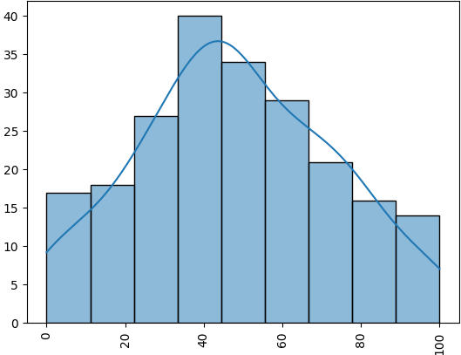
The Dataset
Social Support Score
IQ Score
Life Satisfaction Score
Mean: 48.03
Std: 25.07 Min: 0 Max: 100
Depression Score
Stress Level
Attention Score
Measures the perceived availability and adequacy of social support an individual has from their social network, including friends, family, and the community.
Anxiety Level
Memory Score
Self-Esteem Score
Age
1.6

Slide 10
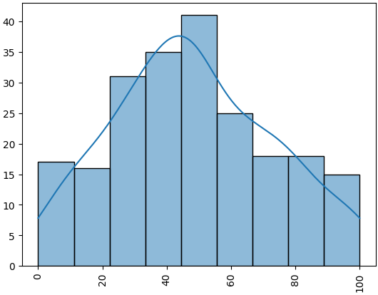
The Dataset
Attention Score
IQ Score
Life Satisfaction Score
Mean: 48.15
Std: 24.8 Min: 5 Max: 97
Depression Score
Social Support Score
Stress Level
Evaluates an individual's ability to sustain focus and concentration. Higher scores suggest better attentional control and focus.
Anxiety Level
Memory Score
Self-Esteem Score
Age
1.7

Slide 11
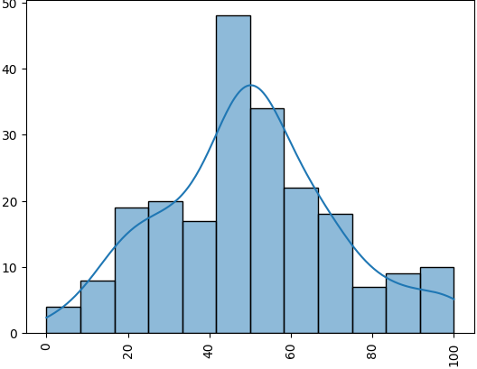
The Dataset
Memory Score
IQ Score
Life Satisfaction Score
Mean: 49.97
Std: 21.43 Min: 2 Max: 99
Depression Score
Social Support Score
Stress Level
Attention Score
Assesses the ability to retain and recall information. Higher scores indicate better memory performance.
Anxiety Level
Self-Esteem Score
Age
1.8

Slide 12
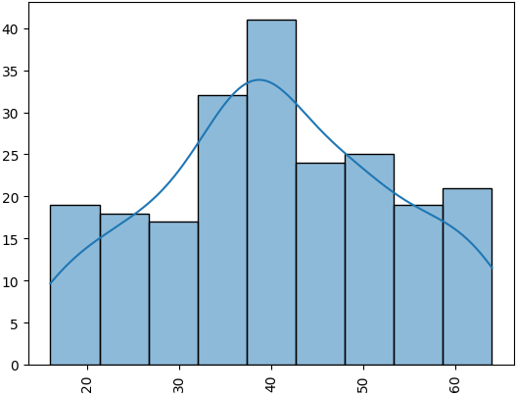
The Dataset
Age
IQ Score
Life Satisfaction Score
Mean: 40.48
Std: 12.98 Min: 16 Max: 64
Depression Score
Social Support Score
Stress Level
Attention Score
Represents the chronological age of the individuals in the dataset.
Anxiety Level
Memory Score
Self-Esteem Score
1.9

Slide 13
The Dataset
IQ Score
Life Satisfaction Score
Depression Score
Social Support Score
Stress Level
Attention Score
Anxiety Level
Memory Score
Self-Esteem Score
Age
1

Slide 14

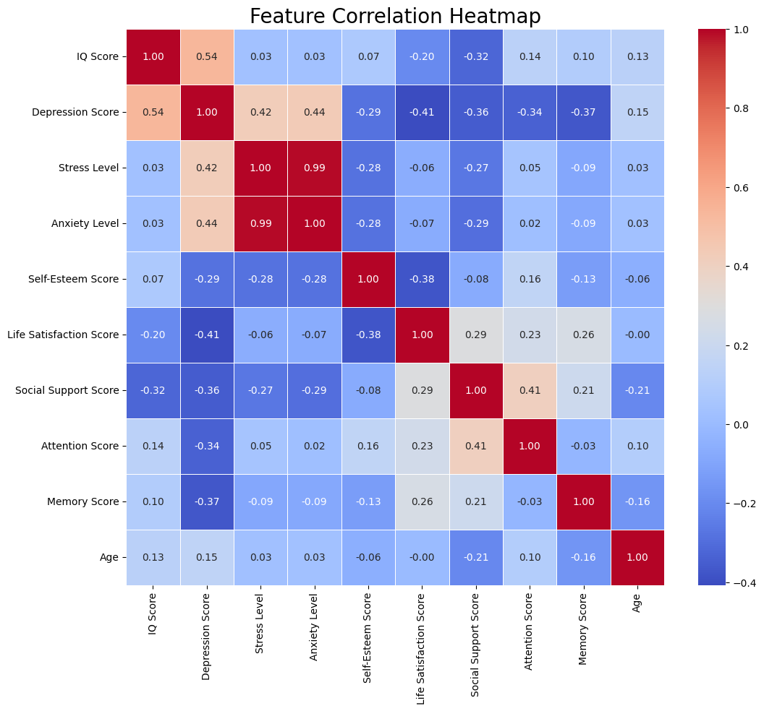
Correlations
Observations:
Strong positive correlation between Stress Level and Anxiety Level (possibly a mistake in dataset composition)
Moderate negative correlation between Depression and Memory, Attention, Social Support and Life Satisfaction scores
Moderate positive correlation between Depression and Stress, Anxiety levels, as well as IQ
Moderate positive correlation between Social Support Score and Attention Score
Moderate negative correlation between Life Satisfaction and Self-Esteem
Moderate negative correlation between Social Support and IQ
2

Slide 15

Hypotheses
Sex affects Depression score
Sex categorical variable splits the dataset into two groups. We deemed it interesting to explore, whether there is a difference around main variable of the dataset.
Age negatively affects Social Support
As we age, we spend less time socializing, therefore, our perception of social support becomes pessimistic. This was our attempt at explaining slight negative correlation.
Depression negatively affects Attention
The dataset was made to explore depression effects on memory and attention. We acknowledge this by trying to check connection between at least these two.
3

Slide 16
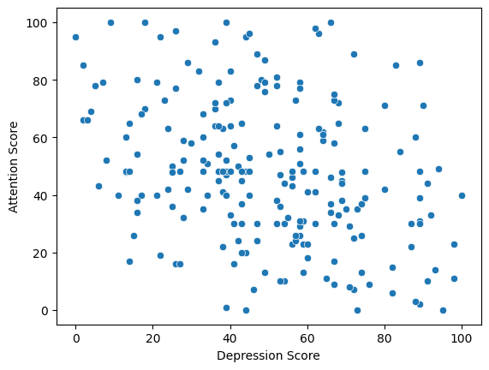
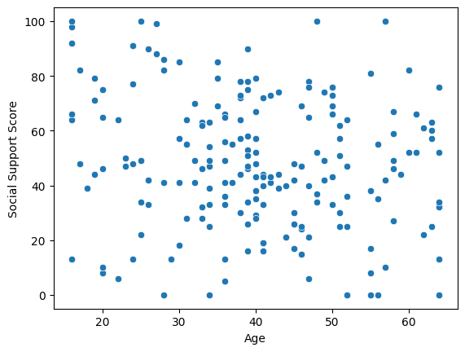
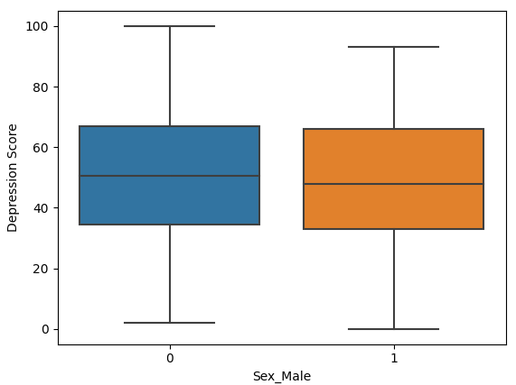
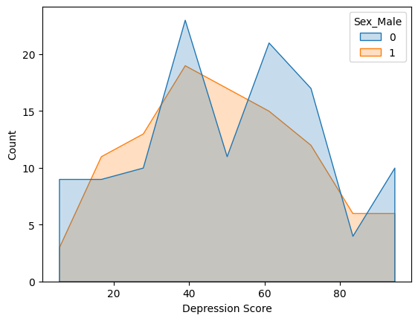
Data analysis related to Hypotheses
4

Slide 17
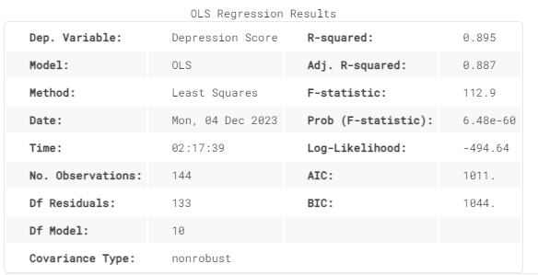
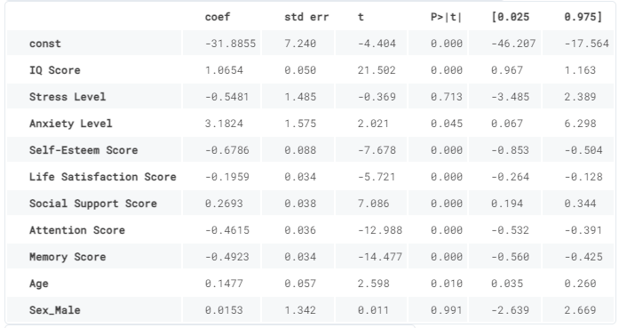
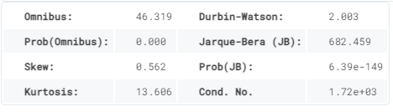
Models: Sex/Depression Score
5

Slide 18
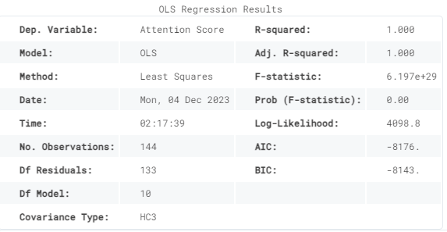
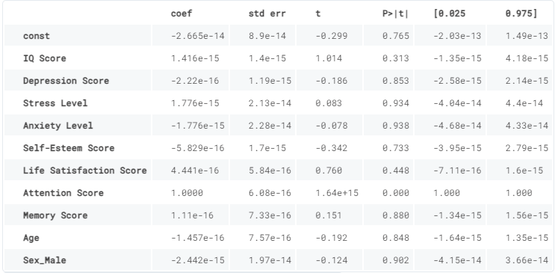
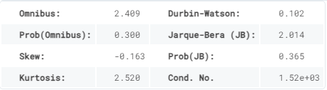
Models: Age/Social Support Score
6

Slide 19
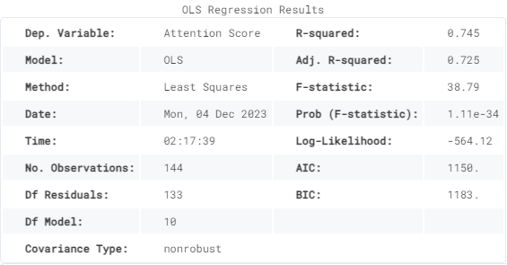
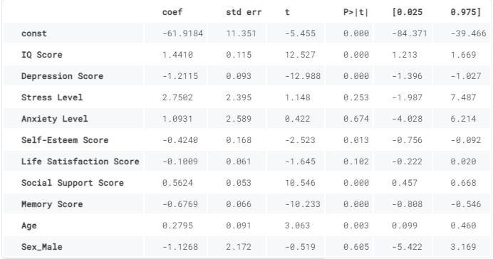
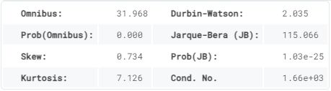
Models: Depression Score/Attention Score
7

Slide 20
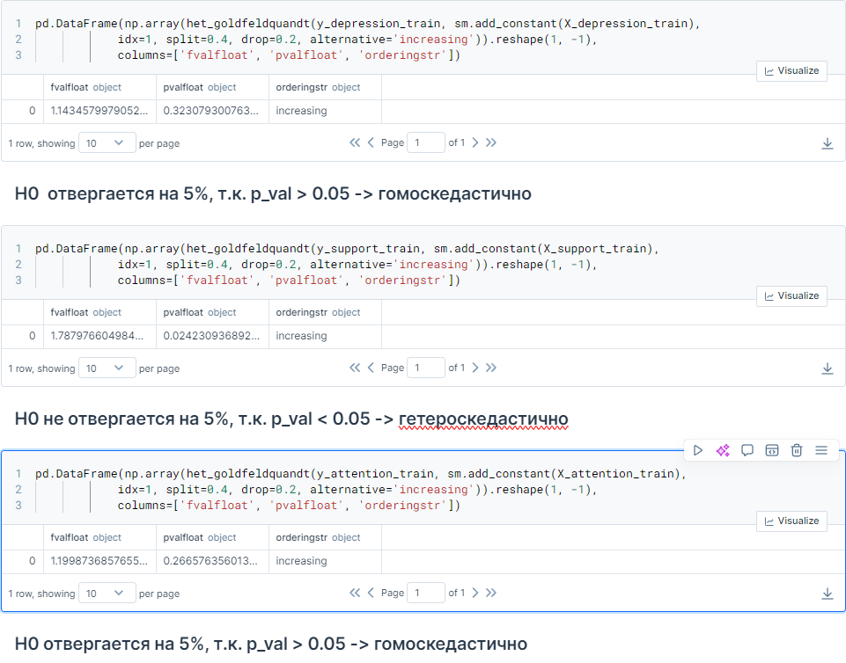
Problems: Heteroskedasticity
8

Slide 21
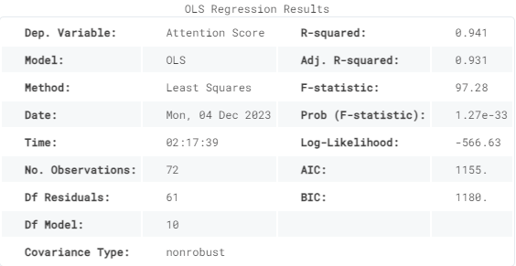
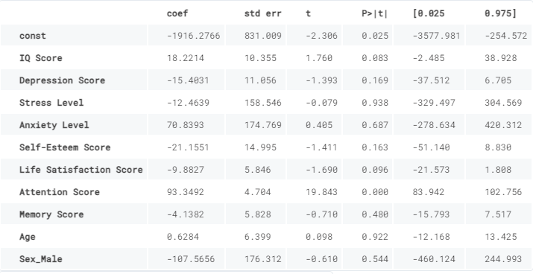
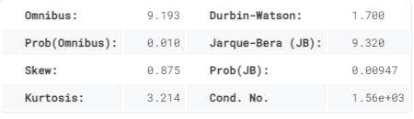
Squared Social Support Model
9

Slide 22
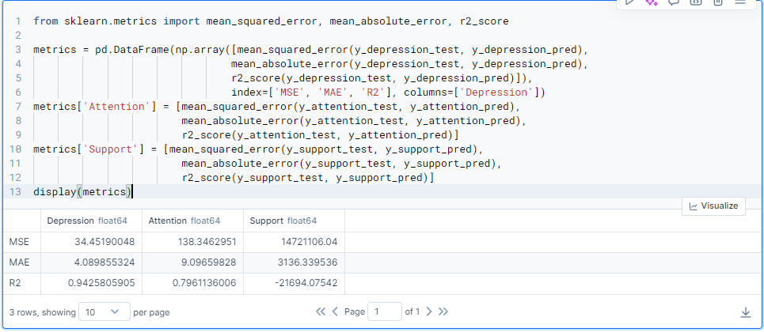
Predictions
10

Slide 23
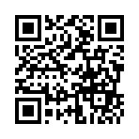
Conclusion
Sex affects Depression score
Sex is not significant for the model, as the p-value is 0.991
Age negatively affects Social Support
Both models for this hypothesis do not show sufficiently good metric results to be considered valid.
Depression negatively affects Attention
The hypothesis is deemed to be statistically supported by our model, as Attention Score shows the p-value of 0 in the model.
11
An easter egg

Slide 24

Thank you!

